Slide 1



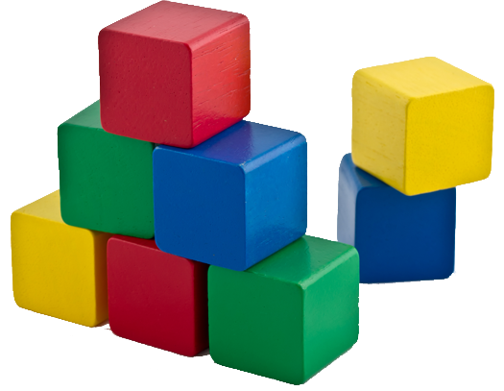


Classes and Class Members
Classes, Constructors, Properties, Methods, Accessors, Static Members
Classes
O
O
SoftUni Team
O
O
Technical Trainers
P
P
Software University
http://softuni.bg

Slide 2



Table of Contents
Objects and Classes
Defining Classes in JS
Constructors and Methods
Accessor Properties
Static Members
Legacy Classes
Protecting Class Data

Slide 3
Have a Question?
sli.do #js-classes

Slide 4

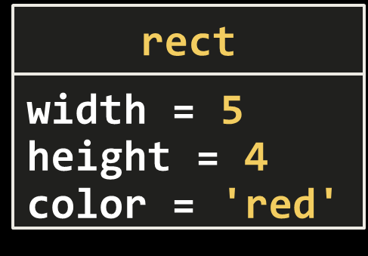
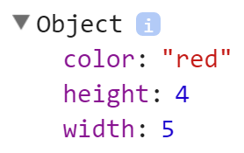
Objects and Classes
Defining and Using Classes in JS

Slide 5
Objects
In programming objects holds a set of named values
E.g. a rectangle object holds width, height
Creating a "rect" object in JS:
Object name
rect
width = 5
height = 4
color = 'red'
Object properties
let rect = { width: 5, height: 4, color: 'red' };

Slide 6
Classes
In programming classes provide the structure for objects
Act as template for objects of the same type
Classes define:
Data (properties, attributes), e.g. width, height, color
Actions (behavior), e.g. calcArea(), resize(ratio)
One class may have many instances (objects)
Example class: Rectangle
Example objects: redRect, blueRect

Slide 7
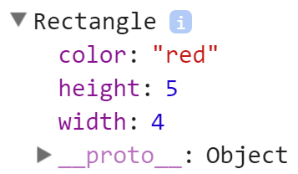
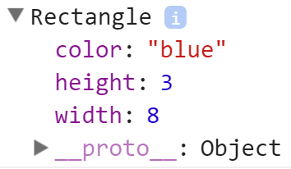
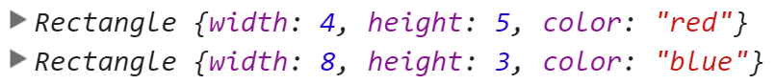
Defining Classes in JS
The constructor defines class data
class Rectangle {
constructor(width, height, color) {
this.width = width;
this.height = height;
this.color = color;
}
}
let redRect = new Rectangle(4, 5, 'red');
let blueRect = new Rectangle(8, 3, 'blue');
console.log(redRect, blueRect);
Create a new object

Slide 8
Classes Holding Data + Methods
class Rectangle {
constructor(width, height, color) {
[this.width, this.height, this.color] =
[width, height, color];
}
calcArea() {
return this.width * this.height;
}
}
Methods perform operations over the class data
let rect = new Rectangle(4, 5, 'red');
console.log(rect.calcArea()); // 20
Check your solution here: https://judge.softuni.bg/Contests/336

Slide 9
Classes vs. Objects
Objects
Classes
object redRect
Object name
Class name
class Rectangle
width = 4
height = 5
color = 'red'
Object data
width
height
color
Class data (properties)
object blueRect
Object name
calcArea()
resize(…)
Class actions (methods)
width = 8
height = 3
color = 'blue'
Object data

Slide 10
Problem: Persons
Create a class Person to hold firstName + lastName + age + email
Define toString() method to print the person in this format:
Write a function getPersons() to return an array of the following persons:
{firstName} {lastName} (age: {age}, email: {email})
First Name | Last Name | Age | Email
Maria | Petrova | 22 | mp@yahoo.com
SoftUni
Stephan | Nikolov | 25
Peter | Kolev | 24 | ptr@gmail.com

Slide 11
Problem: Persons – Output
The getPersons() function should work like this:
console.log(getPersons().join(", "));
Maria Petrova (age: 22, email: mp@yahoo.com), SoftUni undefined (age: undefined, email: undefined), Stephan Nikolov (age: 25, email: undefined), Peter Kolev (age: 24, email: ptr@gmail.com)

Slide 12
Solution: Person Class
class Person {
constructor(firstName, lastName, age, email) {
[this.firstName, this.lastName, this.age, this.email] = [firstName, lastName, age, email];
}
toString() {
return `${this.firstName} ${this.lastName} (age: ${this.age}, email: ${this.email})`;
}
}
Check your solution here: https://judge.softuni.bg/Contests/336

Slide 13
Solution: getPersons() Function
function getPersons() {
class Person { … }
return [
new Person('Maria', 'Petrova', 22, 'mp@yahoo.com'),
new Person('SoftUni'),
new Person('Stephan', 'Nikolov', 25),
new Person('Peter', 'Kolev', 24, 'ptr@gmail.com'),
];
}
Check your solution here: https://judge.softuni.bg/Contests/336

Slide 14
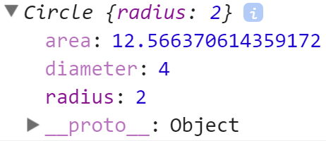
Accessor Properties
class Circle
radius
diameter
area
Defining Getters and Setters

Slide 15
Accessor Properties
Class Circle will hold property "radius" + accessor properties "diameter" and "area"
class Circle {
constructor(radius) { this.radius = radius; }
get diameter() { return 2 * this.radius; }
set diameter(diameter) {
this.radius = diameter / 2;
}
get area() {
return Math.PI * this.radius * this.radius;
}
}
Property getter
Property setter
Read-only property "area"
Check your solution here: https://judge.softuni.bg/Contests/336

Slide 16
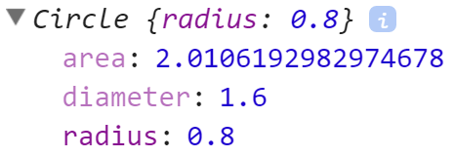
Accessor Properties in Action
let c = new Circle(2);
console.log(`Radius: ${c.radius}`); // 2
console.log(`Diameter: ${c.diameter}`); // 4
console.log(`Area: ${c.area}`); // 12.566370614359172
c.diameter = 1.6;
console.log(`Radius: ${c.radius}`); // 0.8
console.log(`Diameter: ${c.diameter}`); // 1.6
console.log(`Area: ${c.area}`); // 2.0106192982974678

Slide 17
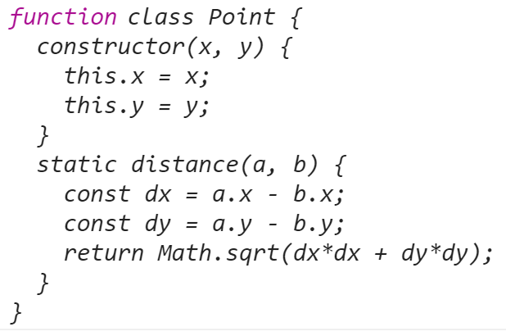
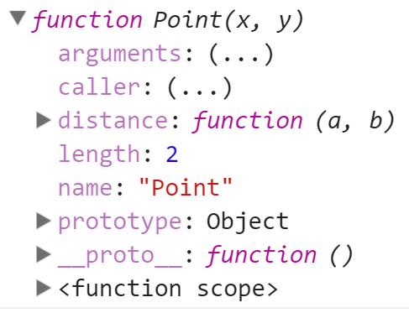
Static Methods

Slide 18
Static Methods
class Point {
constructor(x, y) {
this.x = x;
this.y = y;
}
static distance(a, b) {
const dx = a.x - b.x;
const dy = a.y - b.y;
return Math.sqrt(dx*dx + dy*dy);
}
}
let p1 = new Point(5, 5);
let p2 = new Point(10, 10);
console.log(
Point.distance(p1, p2));
Check your solution here: https://judge.softuni.bg/Contests/336

Slide 19


Legacy Classes in JS

Slide 20
Legacy Classes
Before ES2015 (ES6), classes were composed manually
Constructor function defines class data
function Rectangle(width, height) {
this.width = width;
this.height = height;
}
Rectangle.prototype.area = function () {
return this.width * this.height;
}
let rect = new Rectangle(3, 5);
Behavior (methods) is later attached to the prototype
Instantiation works the same way
Check your solution here: https://judge.softuni.bg/Contests/336

Slide 21
Comparison with the New Syntax
class Rectangle {
constructor(width, height) {
this.width = width;
this.height = height;
}
area() {
return this.width * this.height;
}
}
function Rectangle(width, height) {
this.width = width;
this.height = height;
}
Rectangle.prototype.area = function() {
return this.width * this.height;
}

Slide 22



Protecting Class Data
Keeping the Class State Correct

Slide 23
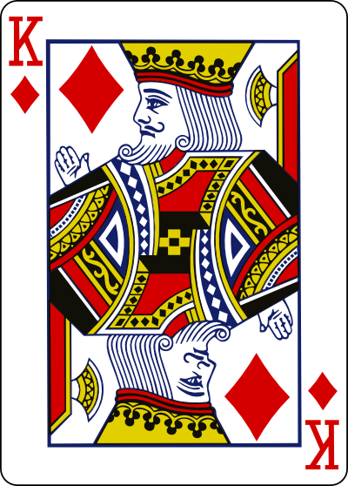
Problem: Cards
Write a function that returns a class Card and a enum Suits:
Suits is an object with keys [SPADES, HEARTS, DIAMONDS, CLUBS] and corresponding values [♠, ♥, ♦, ♣]
The Card class should hold a Face + Suit:
Face must be in [2, 3, 4, 5, 6, 7, 8, 9, 10, J, Q, K, A]
Suit must be a value from Suites
Card.toString() should return the card as text, e.g. K♦
Creating an invalid Card (e.g. -1♥) should throw an Error

Slide 24
Problem: Cards – Sample Output
let defineCards = (function() { … } () )
let Suits = defineCards.Suites;
let Card = defineCards.Card;
let card = new Card("Q",Suits.DIAMONDS));
console.log('' + card); // Q♦
OK
let card = new Card("1",Suits.DIAMONDS);
Error
let card = new Card("A",Suits.Pesho);
Error
let card = new Card("A",'hearts');
Error

Slide 25
Solution: Create Cards Function
(function() {
let Suits = { CLUBS: "\u2663", // ♣ DIAMONDS: "\u2666", // ♦ HEARTS: "\u2665", // ♥ SPADES: "\u2660" // ♠ };
let Faces = ['2', '3', '4', '5', '6', '7', '8', '9', '10', 'J', 'Q', 'K', 'A'];
class Card { … }
return { Suits, Card }
}())

Slide 26
Solution: Class Card
class Card { constructor(face, suit) { this.suit = suit; this.face = face;
}
get face() { return this._face; } set face(face) { if (!Faces.includes(face)) throw new Error("Invalid card face: " + face); this._face = face; } …
Use different identifier this._face to avoid infinite recursion: set suit() invoking itself

Slide 27
Solution: Class Card (2)
class Card {
… get suit() { return this._suit; } set suit(suit) { if (!Object.keys(Suits).map(
k => Suits[k]).includes(suit)) throw new Error("Invalid card suite: " + suit); this._suit = suit; }
toString() { return `${this.face}${this.suit}`; }
}
Check your solution here: https://judge.softuni.bg/Contests/336

Slide 28

Practice: Defining Classes
Live Exercises in Class (Lab)

Slide 29


Summary
Classes provide structure for objects
Classes may define methods:
Classes may define accessor properties
Getters and setters:
class Point {
constructor(x, y) {
this.x = x;
this.y = y;
}
}
let p1 =
new Point(2, 3);
let p2 =
new Point(7, 1);
console.log(p1);
console.log(p2);
toString() { … }
get area() { return … }

Slide 30










Classes and Class Members
https://softuni.bg/courses/javascript-advanced

Slide 31
License
This course (slides, examples, demos, videos, homework, etc.) is licensed under the "Creative Commons Attribution-NonCommercial-ShareAlike 4.0 International" license

Slide 32






Free Trainings @ Software University
Software University Foundation – softuni.org
Software University – High-Quality Education, Profession and Job for Software Developers
softuni.bg
Software University @ Facebook
facebook.com/SoftwareUniversity
Software University @ YouTube
youtube.com/SoftwareUniversity
Software University Forums – forum.softuni.bg

